Slide 1
Sprint 4
HEALTHY BELLY

Slide 2

Document Updates
Business Requirement Document: No major updates!
Management Plan
Updated Gantt Chart
Updated Burndown Chart
Updated Project Tracking Matrox
Updated Sprint Board
Notes:
Mateo

Slide 3

Focus of this Sprint
We continue to learn more things about Android Studio and mobile development in general
We are constantly testing out different UI elements
The focus of the team is on two main user stories:
As a user I should be able to scan a barcode and get feedback
As a user I should be able to search for an item and get feedback
The 2 user stories require us to get data from a food database (More on that later!)
Notes:
Josue

Slide 4

Sprint points
Our primary focus for this sprint was the scanner and the database
Story points planned: 60
Story points completed: 30
We ran into some problems like why doesn't our camera work on android 10?
Notes:
Josue

Slide 5

Major Changes
Switching Ingredient database from OpenFoodFacts to the following possibilities: - USDA Food database API - Edamam API
Switching from AWS to Firebase or DigitalOcean - Why was AWS charging us?
At this point we might have to start selling shirts!
Notes:
Big BOIIIIIIIIIIIII

Slide 6
Food Data Central vs Edamam vs Open food facts
Food Data Central:
Its provided by the US Department of Agriculture
Information is accurate and reliable
Restricted to United States
Limited search limit
Edamam Food Database
Privately owned Database
Free version limits searches
Allows searches for macro and micro nutrients, allergen labels, lifestyle and health labels
Open Food Facts:
Its open source, meaning it can turn the app global
No limit on searches
Information can be edited by anyone, so it is not a reliable source
Notes:
Hassan

Slide 7
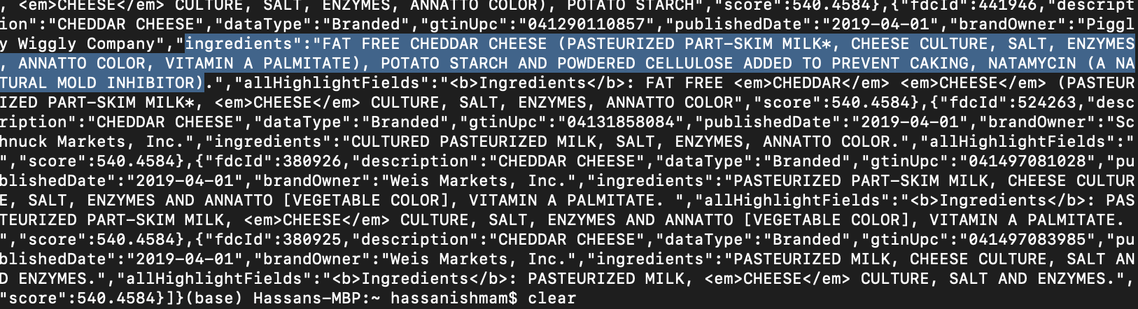
API Call
Notes:
Hassan

Slide 8
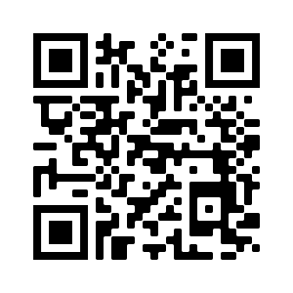

Scanner
ZBar is an open source software suite for reading barcodes from various sources, such as video streams, image files and raw intensity sensors. It supports many popular symbologies (types of barcodes)
Another Library we discovered is ZXing, but it seems to have a lot of issues with current phones
Notes:
Marty

Slide 9
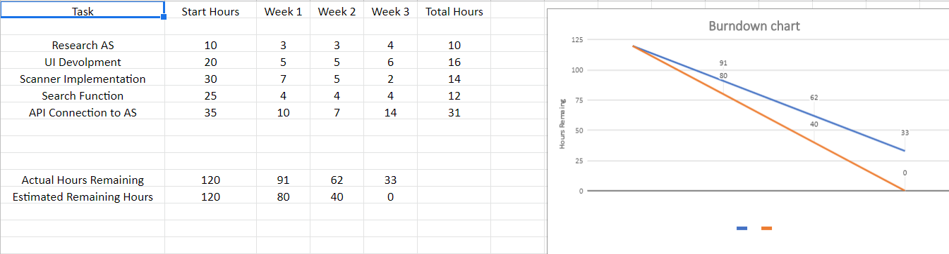
Burndown chart
Notes:
Mateo

Slide 10
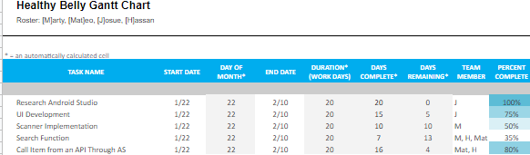
Gantt Chart
Notes:
Mateo

Slide 11
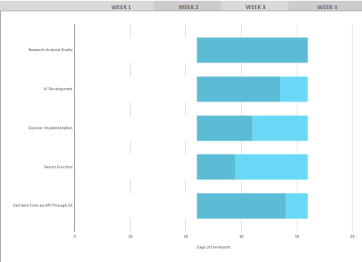
Gantt Chart
Notes:
Mateo

Slide 12
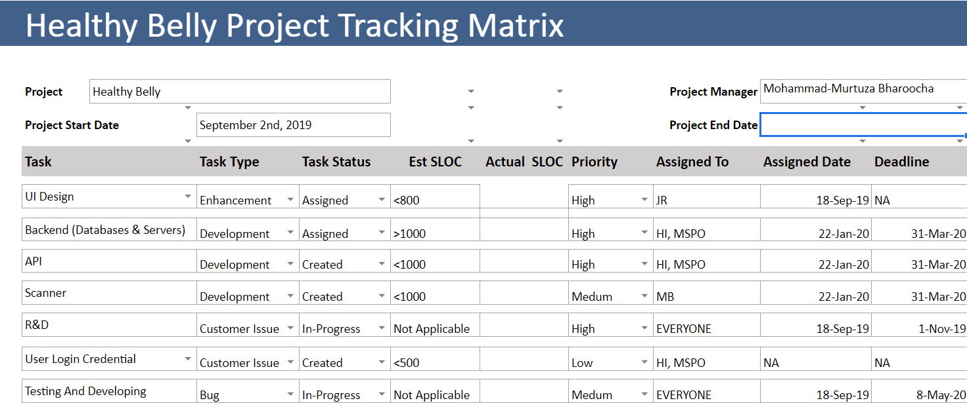
Project Tracking Matrix
Notes:
Mateo

Slide 13
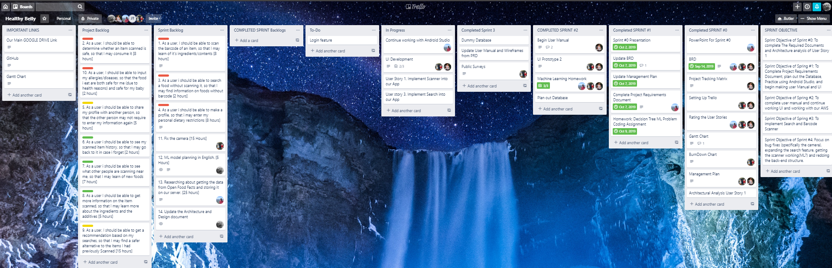
Sprint Board
Mateo?
Notes:
Mateo

Slide 14
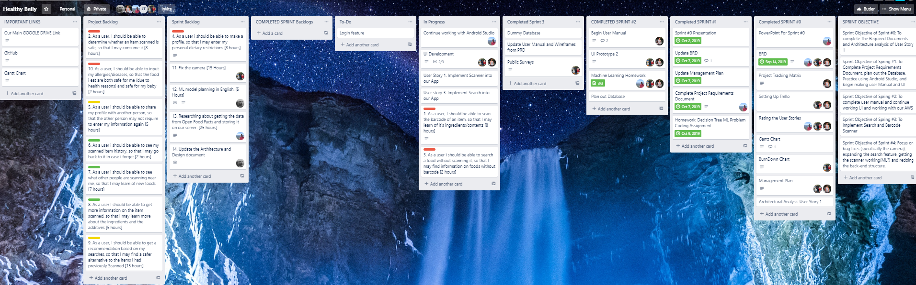
Sprint Board
Mateo?
Notes:
Mateo

Slide 15
Sprint retrospective
We didn’t accomplish all our user stories/tasks due to working on the more difficult user stories
We are still making adjustments to improve our workflow
We are currently not releasing Code for review
Notes:
Josue

Slide 16
END OF PRESENTATION
:)

